Slide 1
Analyzing NCAA Men’s Basketball Conferences
Dustin Casey
DSC530 - Data Exploration and Analysis

Slide 2
Abstract and Hypothesis
As a big sports fan and Minnesota Golden Gophers fan, I wanted to see which conferences had the most success in NCAA Men’s Basketball.
Questions to answer:
Which conferences are the most successful?
What relationships are there between teams and winning?
Hypothesis:
The Big10 conference will perform better in the regular season than the other major conferences.

Slide 3
The Data and Variables
Two datasets: regular season results and NCAA tournament results from 1996-2017.
Variables Analyzed:
Team’s Conference
Opponent’s Conference
Points Scored
Points Allowed
Points Margin
Game Attendance

Slide 4
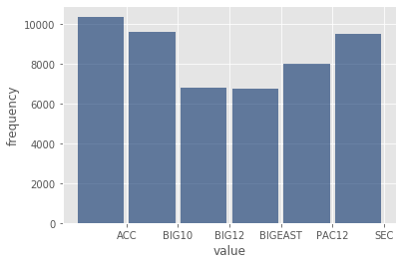
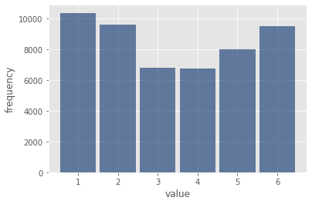
Conference Abrv.
Histogram of counts by conference.
Mean: 3.41
Median: 3.0
Mode: 1
Spread: 3.27
Tails: 1.81

Slide 5
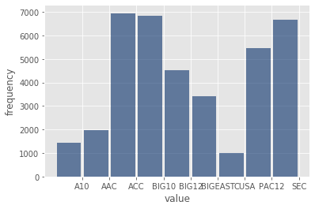
Conference of Opponents
Mean: 13.39
Median: 8.0
Mode: 3
Spread: 89.11
Tails: 9.44

Slide 6
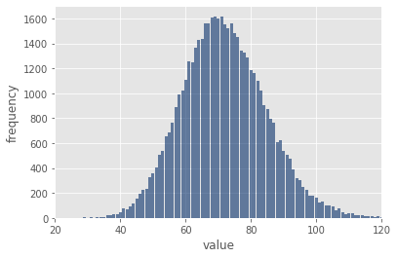
Points Scored
Mean: 13.39
Median: 8.0
Mode: 3
Spread: 89.11
Tails: 9.44

Slide 7
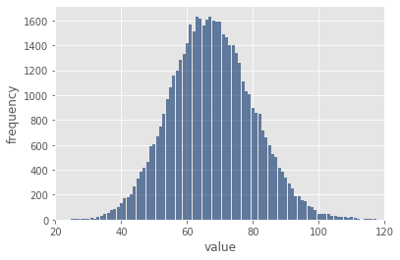
Points Allowed
Mean: 67.54
Median: 67.0
Mode: 67
Spread: 157.57
Tails: 12.55

Slide 8
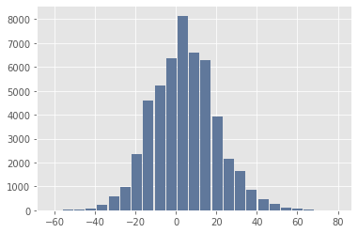
Points Margin
Mean: 4.33
Median: 4.0
Mode: 3
Spread: 250.54
Tails: 15.83

Slide 9
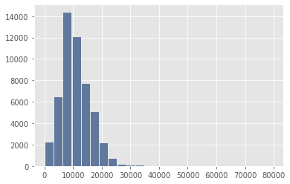
Points Allowed
Mean: 11,033.24
Median: 10250.0
Mode: 9314, 16300
Spread: 29,258,717.07
Tails: 5409.13

Slide 10
Probability Mass Function (PMF) of Winning Teams vs Losing Teams Points per Game

Slide 11
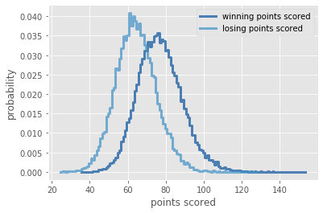
PMF of Points Scored
Showing that the probability of a higher score lies with the winning teams.
This would be expected as if you score more points, the likelihood of winning increases.

Slide 12
Cumulative Distribution Function (CDF) of Attendance by Winning and Losing Teams

Slide 13
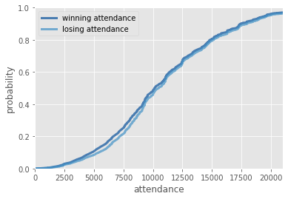
CDF of Attendance
Slight difference in attendance between winning and losing teams, but overall not much of a difference.

Slide 14
Normal Distribution of Points Margin

Slide 15
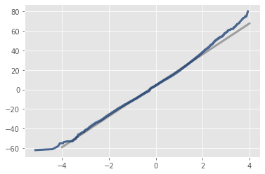
Normal Probabilities Plot (NPP) of Points Margin
I believe a normal distribution fits best for the points margin variable because from the histogram, it appeared to have a normal distribution.
After running a Normal Probability Plot (NPP), the normal distribution line aligns well with the modelled distribution.
Although the lines deviate slightly after 2 standard deviations, I believe the fit is still the best possible.

Slide 16
Scatter Plots and Correlation Tests for Points Scored and Points Allowed vs Points Margin

Slide 17
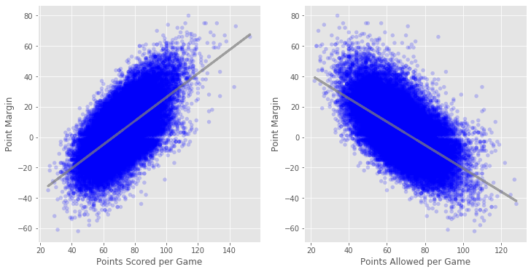
Points Scored and Points Allowed vs Points Margin
Correlation tests between Points Scored per Game and Point Margin
Covariance: 129.61
Pearson's Corr: 0.635
Spearmans's Corr: 0.608
Correlation tests between Points Allowed per Game and Point Margin
Covariance: -120.93
Pearson's Corr: -0.609
Spearmans's Corr: -0.600

Slide 18
Points Scored and Points Allowed vs Points Margin
Based on the Pearson and Spearman Correlations, Points Scored per Game and Points Margin have a medium to strong positive correlation.
Based on the Pearson and Spearman Correlations, Points Allowed per Game and Points Margin have a medium to strong negative correlation.

Slide 19
Hypothesis Test on Big10 versus Other Conferences – Likelihood of Winning

Slide 20
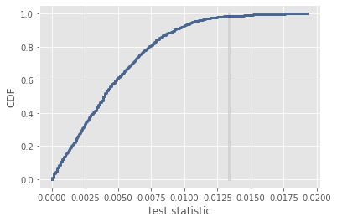
Likelihood of Winning
Hypothesis: The Big 10 would be as successful or more successful at winning than other conferences.
P-Value: 0.015
After running Hypothesis Test, with a p-value of 0.015, the null hypothesis is true. Teams from the Big 10 are as likely to win or have success as teams from other conferences.

Slide 21
Regression Analysis – Predicting Wins from Attendance

Slide 22
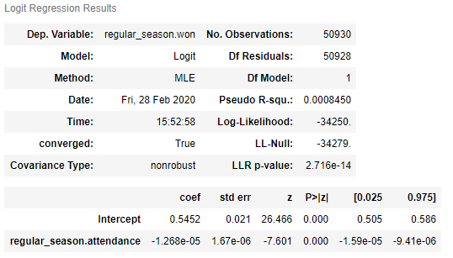
Logistic Regression of Wins using Game Attendance
Using Attendance to predict games, it appears to be a bad fit for the model wit ha Pseudo R-squared of 0.000845.
I wanted to see if Attendance had any impact on the game’s outcome because a lot of people think it has a major impact.

